Slide 1
ALM Refresher
Kyle A. Pitzer
Advanced Data analysis
2/12/20

Slide 2
Learning Objectives
Refresh linear modeling foundations and concepts
Introduce students to linear modeling in R for those who have not done it
Conduct linear regression analysis independently
Interpret results of a linear model

Slide 3
The Linear Model
Linear models can be used to predict or explain a continuous outcome using a single or several independent/predictor variables.
The linear model can be written in several different ways.
y = mx + b
y = $b_{0}$ + $b_{1}x$
y = $a$ + $b_{1}x$
The critical elements of each equation are the outcome variable, the intercept, slope, and the predictor variable.

Slide 4
Example: Fruit consumption and weight
For this example, we will walk through each step of linear modeling using the brfss excerpt from the “statsr” package.
Specifically, we will be looking at the effect of fruit consumption on weight.
Using our variables, our simple model looks like this:
weight = $b_{0}$ + $b_{1}$fruitconsumption
where weight is our outcome and fruit consumption is our predictor of interest.

Slide 5
Visualizing the relationship
Before we run our model, we can visualize the relationship between fruit consumption and weight.
#plot the relationship between fruit consumption and weight ggplot(brfss, aes(y = weight, x = fruit_per_day)) + geom_smooth(method = "lm", se = FALSE, na.rm = T) + geom_jitter(na.rm = T) + geom_point(na.rm = T, size = 2, alpha = .2) + labs(title = "Fruit Consumption and Weight", y = "Weight (lbs)", x = "Fruit Consumption (per day)") + theme_bw()

Slide 6
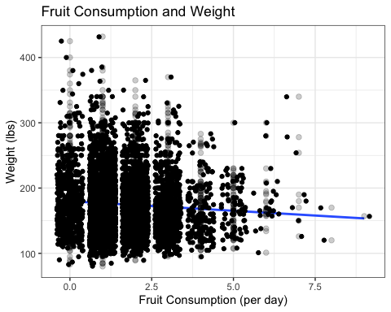
The relationship between fruit consumption and weightappears to be slightly negative.

Slide 7
Modeling our Data
In order to model our data, we use the lm() function, which stands for linear model.
For our linear model, our outcome is weight and our predictor of interest is fruit consumption per day.
Our model looks like this in R:
weight.mod <- lm(weight ~ fruit_per_day, data = brfss)

Slide 8
Examining our results
In order to see our results, we have to wrap summary() around our model object.
summary(weight.mod) ## Coefficients: ## Estimate Std. Error t value Pr(>|t|) ## (Intercept) 179.8712 1.0949 164.277 < 2e-16 *** ## fruit_per_day -2.9303 0.5573 -5.258 1.52e-07 *** ## --- ## Signif. codes: 0 '***' 0.001 '**' 0.01 '*' 0.05 '.' 0.1 ' ' 1
It looks like our prediction based on the visualization was correct.

Slide 9
Multivariate linear model
Next, let’s add a few confounders to our model - sex, height, and exercise.
The model now looks like this:
Our model looks like this in R:
weight.mod2 <- lm(weight ~ fruit_per_day + sex + height + exercise, data = brfss)

Slide 10
Results of multivariate model
Now we can use summary() again to look at our multivariate model.
summary(weight.mod2) ## Coefficients: ## Estimate Std. Error t value Pr(>|t|) ## (Intercept) -160.5633 12.0454 -13.330 < 2e-16 *** ## fruit_per_day -0.2246 0.4803 -0.468 0.64 ## sexFemale -7.3449 1.4621 -5.024 5.25e-07 *** ## height 5.0283 0.1714 29.342 < 2e-16 *** ## exerciseNo 12.1135 1.2563 9.642 < 2e-16 *** ## --- ## Signif. codes: 0 '***' 0.001 '**' 0.01 '*' 0.05 '.' 0.1 ' ' 1
Now it looks like fruit consumption isn’t as explanatory as we thought.
We can now fill in our linear model as follows: weight = -160 + -0.2(fruit consumption) + -7.3(sex) + 5.02(height) + 12.11(exercise)

Slide 11
Evaluating estimates
Given the p value, we can make conclusions about whether we reject or fail to reject the null (slope = 0).
We can also get confidence intervals using confint()
confint(weight.mod2)
## 2.5 % 97.5 % ## (Intercept) -184.177595 -136.9491041 ## fruit_per_day -1.166309 0.7170799 ## sexFemale -10.211226 -4.4786042 ## height 4.692375 5.3643065 ## exerciseNo 9.650558 14.5763645
This tells us the range of possible values in the population.

Slide 12
Interpreting estimates
For continous variables, such as height, we would interpret this as the change in weight given a 1 unit increase in height.
For categorical variables, such as exercise, this is the change in weight for someone who does exercise compared to someone who does not.
Understanding these interpretations is also useful for case prediction based on specified values.

Slide 13
Evaluating the model
There are two primary things to look at when evaluating model fit: the F statistic and adjusted R squared.
The F statistics and accompanying p value tells us whether the model is better than the mean/null model at explaining variation in the outcome. When the p value is less than .05, that means that we can reject the null that the model is the same as the null model in terms of its ability to explain the outcome.
The R squared tells us how much of the variation (%) is explained by the model. For instance, in our model, the adjusted R squared is .31, therefore the model explains 31% of the variation in weight.
## Residual standard error: 36.33 on 4995 degrees of freedom ## Multiple R-squared: 0.3114, Adjusted R-squared: 0.3108 ## F-statistic: 564.6 on 4 and 4995 DF, p-value: < 2.2e-16

Slide 14
Assumptions
There are four assumptions that need to be fulfilled in order to generalize our model to the population.
First, there needs to be a linear relationship between predicted values and residuals.
Second, there must be independence of residuals.
Third, residuals need to be distributed normally
Lastly, there needs to be equal variance of residuals.

Slide 15
Checking linearity
In order to check linearity, we can look at a scatterplot for predicted weight and residuals.
# check linearity of plot of residuals and predicted values ggplot(brfss, aes(y = residuals, x = predicted)) + geom_smooth(method = "lm", se = FALSE) + geom_smooth(se = FALSE) + geom_point(size = 2, alpha = .2) + labs(y = "Residuals (unexplained variability)", x = "Predicted weight") + theme_bw() + ggtitle("Residuals and predicted values")

Slide 16
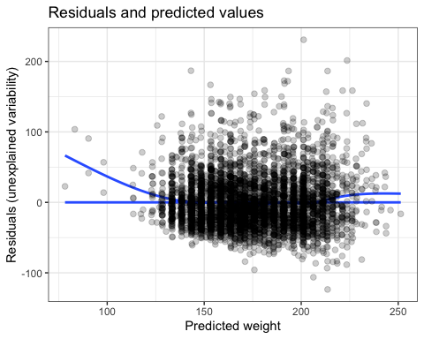

Slide 17
Checking indepedence
Next, we can check independence using the Durbin-Watson test, in which the null hypothesis is that the residuals ARE independent.
#check residuals for independence dwtest(weight.mod2)
## ## Durbin-Watson test ## ## data: weight.mod2 ## DW = 1.9896, p-value = 0.3571 ## alternative hypothesis: true autocorrelation is greater than 0

Slide 18
Checking normality
We can check normality of residuals using the Shapiro-Wilk test, in which the null hypothesis is that the residuals ARE normally distributed.
# check normality statistically with the Shapiro-Wilk test shapiro.test(brfss$residuals)
## ## Shapiro-Wilk normality test ## ## data: brfss$residuals ## W = 0.937, p-value < 2.2e-16

Slide 19
Checking homoscedasticity
Lastly, we can use the Breusch-Pagan test to see whether our residuals have constant variance. In this test, the null hypothesis is that variance IS constant.
# check homoscedasticity with bp test bptest(weight.mod2)
## ## studentized Breusch-Pagan test ## ## data: weight.mod2 ## BP = 71.313, df = 4, p-value = 1.199e-14

Slide 20
What to do when failing assumptions
Report results with generalizing to the population
Re-specify the model with different (BUT APPROPRIATE) variables
Transform variables

Slide 21
In-class Activity
Use the data for North Carolina births (nc) in the statsr package to follow the procedure described in today’s lecture
See https://cran.r-project.org/web/packages/statsr/statsr.pdf for information about the data set.
Choose 1 outcome and at least 2 predictors
Document your procedures and report your results in the same Rmd, and submit for participation points

